Slide 1

Growing As Children of Light
Notes:
This graphic came from Jason Hardin. I am certain have I have used notes from Mark Copeland’s EO series, Randy Yerby, Aaron Fleenor and other in making these powerpoints. Further, images have been used from the internet that remain property of their owners. This can not be sold or used commercially. It can only be used for classroom (Bible class) purposes.

Slide 2


Eyeing Second Peter
Building On God’s Promises
Escaping the Corruption in the World
Partaking of the Divine Nature
Week 3

Slide 3
Memory Passage: 2 Peter 1:3-4
According as his divine power hath given unto us all things that pertain unto life and godliness,
through the knowledge of him that hath called us to glory and virtue:
Whereby are given unto us exceeding great and precious promises:
that by these ye might be partakers of the divine nature,
having escaped the corruption that is in the world through lust.

Slide 4


Eyeing Second Peter
Weekly study plan:
Read 2 Peter once a week
Work on the memory verse by reading it carefully aloud at least eleven times this week
Any study on next weeks topic in the text from next week’s topic: Building on Faith

Slide 5
Remembering Second Peter: Mnemonics
Blindness and Myopia Control
Eyes Full of Adultery
Twinkling of an Eye
Holiness – Heresy – Hope
Cultivate Christian Character
Condemnation of false teachers
Confidence in Christ’s return

Slide 6
Diligence
Growing As Children of Light
Week 3

Slide 7
2 Peter 1:2-13
Grace and peace be multiplied unto you through the knowledge of God, and of Jesus our Lord,³ According as his divine power hath given unto us all things that pertain unto life and godliness, through the knowledge of him that hath called us to glory and virtue:⁴ Whereby are given unto us exceeding great and precious promises: that by these ye might be partakers of the divine nature, having escaped the corruption that is in the world through lust.⁵ And beside this, giving all diligence, add to your faith virtue; and to virtue knowledge;⁶ And to knowledge temperance; and to temperance patience; and to patience godliness;⁷ And to godliness brotherly kindness; and to brotherly kindness charity.⁸ For if these things be in you, and abound, they make you that ye shall neither be barren nor unfruitful in the knowledge of our Lord Jesus Christ.⁹ But he that lacketh these things is blind, and cannot see afar off, and hath forgotten that he was purged from his old sins.¹⁰ Wherefore the rather, brethren, give diligence to make your calling and election sure: for if ye do these things, ye shall never fall:¹¹ For so an entrance shall be ministered unto you abundantly into the everlasting kingdom of our Lord and Saviour Jesus Christ.¹² Wherefore I will not be negligent to put you always in remembrance of these things, though ye know them, and be established in the present truth.¹³ Yea, I think it meet, as long as I am in this tabernacle, to stir you up by putting you in remembrance;

Slide 8
Review:
One final command
2 Peter 3:18¹⁸ But grow in grace, and in the knowledge of our Lord and Saviour Jesus Christ. To him be glory both now and for ever. Amen.
What does it mean to grow in the knowledge of Jesus Christ?
How can we be sure that we are growing in this “knowledge”?

Slide 9
Review: The Development of Graces…
Briefly defined…
Faith – “conviction and strong assurance”
Virtue – “moral excellence, goodness”
Knowledge – “correct insight”
Self-control - "self-discipline"
Perseverance - "bearing up under trials"
Godliness - "godly character out of devotion to God"
Brotherly Kindness - "love toward brethren"
Love - "active goodwill toward others“
In conjunction… “add” – 2 Peter 1:5 - epichoregeo - "Originally, to found and support a chorus, to lead a choir, to keep in tune“; Suggests the idea of "each grace working in harmony with the others to produce an overall effect"

Slide 10
With All Diligence!
2 Peter 1:5
It means "earnestness, zeal, sometimes with haste"
We do not "accidentally" or "naturally" develop these graces!
Effort and effectiveness
“We may have been Christians for a number of years; but unless we ‘add’ to our faith these Christ-like qualities with all ‘diligence’, we are simply repeating the first year over and over again!” (J.Kerns)

Slide 11

Introduction
From the beginning, God planned that man would labor and work (Genesis 2:15).
The attitude one brings to their work is defined in two polarizing terms – diligence or laziness.
In Matthew 25:25, the lazy servant is condemned as wicked with his talents given to the servant who had been diligent.
In contrasting these two ideas, one can observe the fruits and consequences of both.
There are many things that the Christian must apply diligence to their godly life.

Slide 12
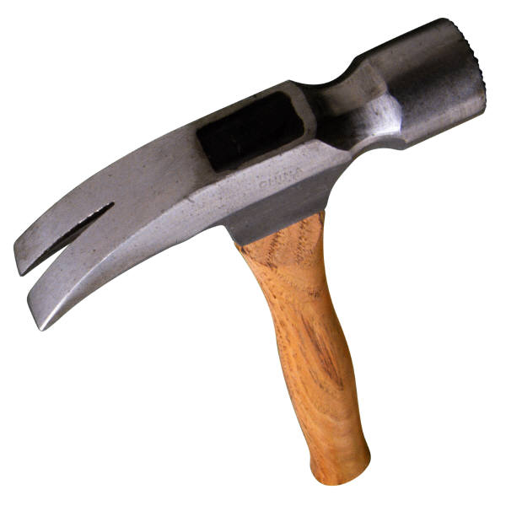
Diligence Defined
Diligence cannot be replaced by any other skill, intelligence, or education. Diligence can be learned.
Diligence is defined by the American Heritage Dictionary as “persistent application to one’s occupation or studies, attentive care, heedfulness.”
One who is diligent is characterized by perseverance and painstaking effort.
There are many words associated with diligence such as attention, persistence, meticulousness, thoroughness, conscientiousness, industry, hard work, studiousness, and carefulness.
Diligence requires effectiveness and efficiency to also be included.
In other words, it more than just hard work.
One can cut down a tree with a hammer, but a saw is used by one who is being diligent.
Diligence is a precious possession to the child of God’s character.
It is the hour one puts in before the rest of the group shows up.
Diligence is a skill one learns to attain the result of pure and right or excellence.

Slide 13

Laziness Defined
Laziness comes from wanting the most for the least input.
It is the path of least resistance.
Laziness is defined by the American Heritage Dictionary as “resistant to work, disposed to idleness.”
Laziness is a form of carelessness. It is the antithesis to diligence.
Too much sleep is one of the things that keeps one from working (See Proverbs 6:9-11, 19:15, 20:1-3, 26:14).
The lazy are full of excuses.
Proverbs 26:16 tells how the lazy are wise in their own view.
Further, the lazy waste what they have (Proverbs 24:3-31).

Slide 14

Diligence and Laziness Defined
Proverbs 12:27 reads, “The lazy man does not roast what he took in hunting, But diligence is man’s precious possession.”
Clearly, diligence is a precious possession to the Christian’s character.
It is one which ever parent hopes to give their child.

Slide 15
Diligence and Laziness Defined
Eg the man of wealth and power
This man of great influence and wealth was trying to give his son what was far more important -- the skill of diligence.
Proverbs 20:11 reads, “Even a child is known by his deeds, Whether what he does is pure and right.”
Diligence requires persistence, doing right expeditiously, effectively, and efficiently.
Yes, even a child is known by and learns this.
Proverbs 22:29 teaches, “Do you see a man who excels in his work? He will stand before kings; He will not stand before unknown men.”
What are the Fruits of Diligence?

Slide 16

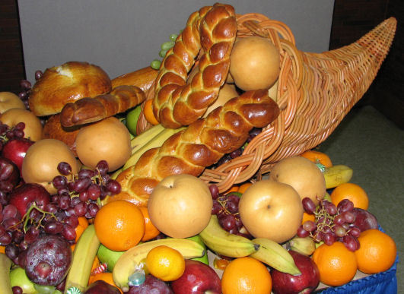
The Fruits of Diligence
First, plenty is provided. Proverbs 21:5 explains, “The plans of the diligent lead surely to plenty, But those of everyone who is hasty, surely to poverty.”
Second, the diligent will rule. Consider Proverbs 12:24:“The hand of the diligent will rule, But the lazy man will be put to forced labor.
Third, there is fulfillment for the diligent. Proverbs 13:4 teaches, “The soul of a lazy man desires, and has nothing; But the soul of the diligent shall be made rich.”

Slide 17

The Fruits of Diligence
Fourth, there is favor for diligent as they earn respect. Proverbs 11:27 teaches, “He who earnestly seeks good finds favor, But trouble will come to him who seeks evil.”
Fifth, the diligent will be rewarded financially. Proverbs 10:4 remarks, “He who has a slack hand becomes poor, But the hand of the diligent makes rich.”
Proverbs 13:11 similarly teaches, “Wealth gained by dishonesty will be diminished, But he who gathers by labor will increase.”
Contrast: What are the consequences of laziness?

Slide 18
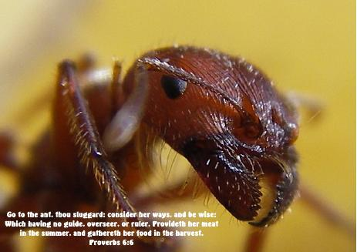
The Consequences of Laziness
Laziness has severe consequences. As Proverbs 21:5 has already instructed, laziness results in poverty.
Proverbs 26:13-16: “The lazy man says, “There is a lion in the road! A fierce lion is in the streets!” 14As a door turns on its hinges, So does the lazy man on his bed.15The lazy man buries his hand in the bowl; It wearies him to bring it back to his mouth.16The lazy man is wiser in his own eyes Than seven men who can answer sensibly.
Proverbs 6:6-11 explains: “Go to the ant, you sluggard! Consider her ways and be wise,7Which, having no captain, Overseer or ruler, 8Provides her supplies in the summer, And gathers her food in the harvest. How long will you slumber, O sluggard? When will you rise from your sleep10A little sleep, a little slumber, A little folding of the hands to sleep— 11So shall your poverty come on you like a prowler, And your need like an armed man.”

Slide 19

The Consequences of Laziness
Proverbs 10:4-5 explains of the shame that comes with laziness, “He who has a slack hand becomes poor, But the hand of the diligent makes rich. 5He who gathers in summer is a wise son; He who sleeps in harvest is a son who causes shame.”
Proverbs 19:15 communicates, “Laziness casts one into a deep sleep, And an idle person will suffer hunger.”

Slide 20

The Consequences of Laziness
Proverbs 20:4 teaches, “The lazy man will not plow because of winter; He will beg during harvest and have nothing.”
Proverbs 21:25-26 tells one that the lazy craves but is unfulfilled, “The desire of the lazy man kills him, For his hands refuse to labor. 26He covets greedily all day long, But the righteous gives and does not spare.”
Proverbs 12:11 explains how the lazy lack understanding, “11He who tills his land will be satisfied with bread, But he who follows frivolity is devoid of understanding.” (See also 28:19).
Proverbs 10:26 teaches how the lazy are odious to others. “As vinegar to the teeth and smoke to the eyes, So is the lazy man to those who send him.”

Slide 21

The Consequences of Laziness
The lazy man has a hedge of thorns as Proverbs 15:19 instructs, “The way of the lazy man is like a hedge of thorns, But the way of the upright is a highway.”
Proverbs 19:24 clarifies an understanding of the nature of the lazy. “A lazy man buries his hand in the bowl, And will not so much as bring it to his mouth again.”
Proverbs 21:25 teaches of a lazy person’s refusal to work: “The desire of the lazy man kills him, For his hands refuse to labor.”
Notice the warning to the lazy in Proverbs 24:30-34: I went by the field of the lazy man, And by the vineyard of the man devoid of understanding; 31And there it was, all overgrown with thorns; Its surface was covered with nettles; Its stone wall was broken down. 32When I saw it, I considered it well; I looked on it and received instruction: 33A little sleep, a little slumber, A little folding of the hands to rest; 34So shall your poverty come like a prowler, And your need like an armed man.

Slide 22

The Consequences of Laziness
Further, notice Proverbs 14:23, “In all labor there is profit, But idle chatter leads only to poverty.”
Lastly, Paul instruct in 1 Timothy 5:13 about how idleness in a group of people leads to the sin of gossip. “13And besides they learn to be idle, wandering about from house to house, and not only idle but also gossips and busybodies, saying things which they ought not.”

Slide 23

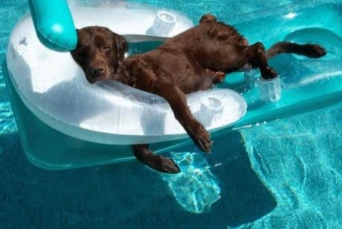
Fruits of Diligence Vs. Consequences of Laziness
Consequences of Laziness
Poverty
Shame
Craves, but unfulfilled
Lacks understanding
Odious to others
Way a hedge of thorns
Idleness leads to other sins
Contrast/ Reflection of others vs. trusting others attitude
Fruits of Diligence
Plenty provided
Diligent rule
Fulfillment
Favor and respect
Reward financially

Slide 24

How to be Diligent
In short, one must stop laziness and get off the path of least resistance.
One must make a decision to accomplish their vision and goals for that which is pure and right (excellence).
The roots of laziness is self-centeredness, pride, and foolishness (ignorance and irresponsibility).
Unfortunately, society is more and more driven by these attitudes and sense of entitlement.
Proverbs 21:2-5 warns: Every way of a man is right in his own eyes, But the Lord weighs the hearts. 3To do righteousness and justice Is more acceptable to the Lord than sacrifice. 4A haughty look, a proud heart, And the plowing of the wicked are sin. 5The plans of the diligent lead surely to plenty, But those of everyone who is hasty, surely to poverty.”

Slide 25

How to be Diligent
Further Proverbs 26:16 (repeat) explains, “The lazy man is wiser in his own eyes Than seven men who can answer sensibly.”
Lastly, understand that laziness increases on itself and is a barrier to success. (See Proverbs 24:30-31, 20:21, 15:19).
This requires one to wakeup to the reality of action and to stop procrastinating (Proverbs 6:9-11).
The diligent must define their vision and goals.
Goals must be big (inspiring), attainable, timed, and translated into daily action.
As one makes their goals, they must seek wise counsel and build on God’s wisdom.

Slide 26

The Christian Life of Diligence & Work
The scriptures teach that one must work to eat.
2 Thessalonians 3:10-12 explains: For even when we were with you, we commanded you this: If anyone will not work, neither shall he eat. 11For we hear that there are some who walk among you in a disorderly manner, not working at all, but are busybodies. 12Now those who are such we command and exhort through our Lord Jesus Christ that they work in quietness and eat their own bread.

Slide 27

The Christian Life of Diligence & Work
There are many even more important areas that require diligence in the life of a Christian.
First, one must keep their heart with diligence.
Proverbs 4:23 teaches, “Keep your heart with all diligence, For out of it spring the issues of life.”
Keeping the heart often means guarding against the input one allows into their mind, whether it be a joke, language, or entertainment.
Second, diligence is required in disciplining and training children.
Proverbs 13:24 notes, “He who spares his rod hates his son, But he who loves him disciplines him promptly.”

Slide 28

The Christian Life of Diligence & Work
Second, diligence is required in disciplining and training children. (Continued)
Deuteronomy 4:9-10 teaches, “9“Only take heed to yourself, and diligently keep yourself, lest you forget the things your eyes have seen, and lest they depart from your heart all the days of your life. And teach them to your children and your grandchildren, 10“especially concerning the day you stood before the Lord your God in Horeb, when the Lord said to me, ‘Gather the people to Me, and I will let them hear My words, that they may learn to fear Me all the days they live on the earth, and that they may teach their children.’”

Slide 29
The Christian Life of Diligence & Work
Deuteronomy 6:6-7 instructs, “And these words which I command you today shall be in your heart. 7“You shall teach them diligently to your children, and shall talk of them when you sit in your house, when you walk by the way, when you lie down, and when you rise up.”
Third, one must be diligent in keeping God’s commandments.
Psalm 119:4 reminds, “You have commanded us To keep Your precepts diligently.”
Deuteronomy 6:17 teaches, “You shall diligently keep the commandments of the Lord your God, His testimonies, and His statutes which He has commanded you.”
Fourth, salvation needs diligence.
Hebrews 4:11 teaches, “1Let us therefore be diligent to enter that rest, lest anyone fall according to the same example of disobedience.”

Slide 30
The Christian Life of Diligence & Work
Fourth, salvation needs diligence. (Continued)
Hebrews 6:9-12 further admonishes: “9But, beloved, we are confident of better things concerning you, yes, things that accompany salvation, though we speak in this manner. 10For God is not unjust to forget your work and labor of love which you have shown toward His name, in that you have ministered to the saints, and do minister. 11And we desire that each one of you show the same diligence to the full assurance of hope until the end, 12that you do not become sluggish, but imitate those who through faith and patience inherit the promises”

Slide 31

The Christian Life of Diligence & Work
Fifth, the Christian must be diligent in seeking God.
Proverbs 8:16 reminds, “I love those who love me, And those who seek me diligently will find me.”
Hebrews 11:6 explains, “6But without faith it is impossible to please Him, for he who comes to God must believe that He is, and that He is a rewarder of those who diligently seek Him.”
Sixth, one must be diligent to oppose error as King Josiah did in 2 Chronicles 34:33.
2 Chronicles 34:33 Thus Josiah removed all the abominations from all the country that belonged to the children of Israel, and made all who were present in Israel diligently serve the Lord their God. All his days they did not depart from following the Lord God of their fathers.
Seventh, diligence is required in leadership as Romans 13:8 instructs.

Slide 32
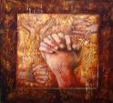
The Christian Life of Diligence & Work
Eighth, godly sorrow produces diligence.
2 Corinthians 7:10-12 instructs: “For godly sorrow produces repentance leading to salvation, not to be regretted; but the sorrow of the world produces death. 11For observe this very thing, that you sorrowed in a godly manner: What diligence it produced in you, what clearing of yourselves, what indignation, what fear, what vehement desire, what zeal, what vindication! In all things you proved yourselves to be clear in this matter. 12Therefore, although I wrote to you, I did not do it for the sake of him who had done the wrong, nor for the sake of him who suffered wrong, but that our care for you in the sight of God might appear to you.”

Slide 33
The Christian Life of Diligence & Work
Nineth, one must know that diligence can fail when one tries to ignore God’s instruction.
Proverbs 1:27-29 explains, “When your terror comes like a storm, And your destruction comes like a whirlwind, When distress and anguish come upon you. 28“Then they will call on me, but I will not answer; They will seek me diligently, but they will not find me. 29Because they hated knowledge And did not choose the fear of the Lord.”
Esau had the same experience when he later diligently sought the birthright.

Slide 34
The Christian Life of Diligence & Work
Diligence is primary in the life of a child of God.
Romans 12:11 instructs the Christian to “not [be] lagging in diligence.”
In general, diligence is seen in many living the life of a Christian.
1 Timothy 5:10 speaks of the widows who “has diligently followed every good work.”
2 Timothy 2:15 admonishes, “15Be diligent to present yourself approved to God, a worker who does not need to be ashamed, rightly dividing the word of truth.”

Slide 35
The Christian Life of Diligence & Work
2 Peter 1:5-11 teaches to give “all diligence” to add faith, virtue, knowledge, self-control, perseverance, godliness, and brotherly kindness. He concludes in verses 10-11, “10Therefore, brethren, be even more diligent to make your call and election sure, for if you do these things you will never stumble; 11for so an entrance will be supplied to you abundantly into the everlasting kingdom of our Lord and Savior Jesus Christ.”
Christians are created in Christ for good works (Ephesians 2:10). Not that the Christian would be save by their works, but that good works is part of what is a Christian.
Clearly, the life of a Christian is one of labor.
1 Corinthians 15:58 remarks, “”Therefore, my beloved brethren, be steadfast, immovable, always abounding in the work of the Lord, knowing that your labor is not in vain in the Lord.”

Slide 36
The Christian Life of Diligence & Work
First, one must keep their heart with diligence.
Second, diligence is required in disciplining and training children.
Third, one must be diligent in keeping God’s commandments.
Fourth, salvation needs diligence.
Fifth, the Christian must be diligent in seeking God.
Sixth, one must be diligent to oppose error.
Seventh, diligence is required in leadership.
Eighth, godly sorrow produces diligence.
Nineth, one must know that diligence can fail when one tries to ignore God’s instruction.
Diligence is primary in the life of a Christian.

Slide 37
Conclusion
From the beginning, God’s plan included work for humans.
Diligence is in sharp contrast to laziness.
Diligence is part of the Christian’s character.
There are many fruits of diligence such as plenty, rule, fulfillment, favor, and financial reward.
Laziness has severe consequences such as poverty, shame, hunger, being unfulfilled, lack of understanding, odiousness to others, a hedge of thorn around him, and can lead to other sins such as gossip.
One can be diligent by putting away self-centeredness, pride, and foolishness.
Instead, one should create godly goals to serve and apply into daily action.

Slide 38
Conclusion
The life of a Christian is full of labor and work.
First, in the worldly sense, if one does not work, then one should not eat.
More importantly, diligence must be applied in other areas of life such as keeping one’s heart, training and disciplining children, keeping God’s commandments, one’s salvation through God, seeking God, opposing doctrinal error, and in leadership.
Diligence is a powerful tool in one’s service to God.
It is primary to a Christian’s life in the work of the Lord.
It is a skill that the Christian should constantly be using in leading a godly life.

Slide 39
Discussion
Create a list of seven specific works of the Lord that you as a Christian should be involved in. Then, grade yourself as diligent or lazy. If you felt you were less than diligent, write a plan of how to improve in this work. For example, one might list the need to teach the lost as completed by home Bible studies on a monthly schedule.

Slide 40
Example: Love My Brethren
Angie Fluharty (on 1/7/9) “Love requires diligent action.”
John 13:35, “By this men will know that you are My disciples, if you have love for one another.” (NASB)
Specific (Purpose/goal/wish)

Slide 41
Example: Teaching My Children
Deuteronomy 6:6-7 “And these words which I command you today shall be in your heart. 7“You shall teach them diligently to your children, and shall talk of them when you sit in your house, when you walk by the way, when you lie down, and when you rise up.”
Specific – Fathers should demonstrate leadership.

Slide 42
Example: Teach The Lost
Specific efforts

Slide 43
Next Week
Building on Faith

